Slide 1
Corporate Finance & Financial Accounting
TERM PROJECT
2019
TEAM 2

Slide 2
TEAM MEMBERS
ANIKET NIRANJAN MISHRA - 17MT3FP20
ROHIT B. NAIR – 17MI10031
ABHIJEET SHRIVASTAVA – 17MI3FP08
ABHISHEK RAO – 17CH3FP17

Slide 3
THE PROBLEM
Reliance Communications Ltd.
What went wrong?

Slide 4
History of RCom
1
The initial days

Slide 5
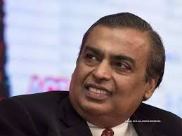
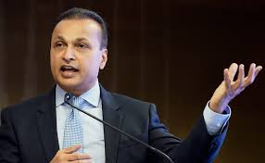
The Split
Reliance Industries
Reliance Industrial Infrastructure
Reliance Infra
Reliance Communications
Reliance Capital
Reliance Power
Reliance Naval
Reliance Home Finance
Reliance Nippon Asset Management

Slide 6

Some facts about its origins
Founded on 31 July 2002 as Reliance Infocomm Limited
Became Reliance Communications Ltd. On 15 July 2004
Introduced GSM service in 2008
Traded as : NSE – RCOM, BSE – 532712
Owners : Reliance ADAG (90%), SSTL (10%)

Slide 7
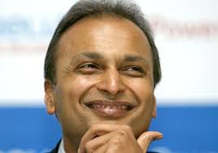
The Good Days
When the situation was not so grim

Slide 8
Facts and figures
Net Worth of Anil Ambani - $45 billion
3,50,781.4 million INR Market Capitalisation
Net adjusted income of 47,190.1 million INR
A very high EPS of 21.92 in 2010
Offered free incoming calls for the first time in industry (Monsoon Hungama offer)
Cuts call rate to Rs. 0.5/minute, triggering industry wide response

Slide 9
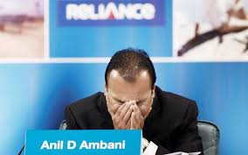
The Current Situation
Looking for help in the family

Slide 10
Facts and figures
Net Worth of Anil Ambani - $0.3 billion
18,252.5 million INR Market Capitalisation
Net adjusted income of 490 million INR
A very low EPS of 0.19 in 2018
Filed bankruptcy at NCLAT (National Company Law Tribunal)
Rs. 45,000 crore debt
Anil avoids jail by paying off Rs. 462 crore dues to Ericsson with help of Mukesh

Slide 11
2010
2G scam involvement
Enters into pact with Polyconn Inc., launches world’s first video conferencing service
Announces launch of 3G services
Signs MoU with CDBC for US$ 1.93 billion loan
2008
Joint venture with Alcatel-Lucent
Introduces 1 paise per SMS for GSM and CDMA, triggers a war of tariffs
2006
Joins hands with Nokia for Nokia 1255 phone
Acquires Yipes for $300 million
Forays into IP television in partnership with Microsoft
Timeline
2011
Launches job search on voice service
Launches 3G services in Rajasthan
Plans next generation mobile portal R World
2012
Refinancing of $1.18 billion FCCBs
Announces partnership with WhatsApp for college students

Slide 12
2014
Launches Disruptive Hi-Speed Unlimited Data Plans
Signs Master Services Agreement with Reliance Jio for sharing of RComs city Fiber Infrastructure
Expands 3G services to 18 circles
2013
RCom and Ericsson sign $ 1 Billion deal for wired and wireless service
Reliance Globalcom delivers first circuit to Mobily
Partners with Twitter in India
2015
Bill Barney appointed as CEO
Reliance and Jasper partner to deliver IoT services across India and make smart cities a reality
Timeline
2017
Aircel-RCom merger called off
RCom sells DTH arm Reliance BIG TV to Pantel, Veecon Media
Reliance Infrastructure sells Mumbai power business to Adani Transmission
2016
RCom announces merger with Aircel

Slide 13
The major factors
2G SCAM
WHAT CAUSED THIS?
ERICSSON DEAL
JIO DEAL

Slide 14



2G SCAM
Occurred in 2010
Heavy involvement of RCom
Swan Telecom Ltd.
ERICSSON DEAL
First signed in 2013
Pulled out in 2017
Had positive as well as negative impacts
JIO ENTRY
Popularity of Jio in 2017
Dwindling market share of RCom

Slide 15
2G SPECTRUM SCAM
Scam loss quantified at Rs. 1.76 lakh crore by C&AG
Reliance ADAG Managing Director Gautam Doshi, senior executives Hari Nair and Surendra Pipara involved
Funded Swan Telecom Pvt Limited (STPL), one of the accused firms
Payments made to Kalaignar TV, accused.
Charged under multiple provisions of IPC including forgery and bribery

Slide 16
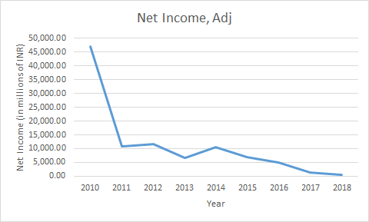
STATS
The 2G Scam occured in 2010, which led to a drastic decrease in the net income of the company.
Source: Bloomberg

Slide 17
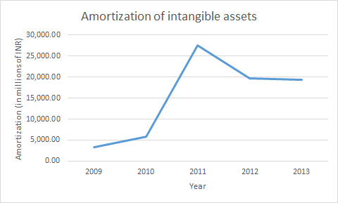
STATS
Due to 2G Scam, the value of asset has been decreased in 2010. Thus, amortization has increased which basically is a clear representation of the increased risk.
Source: Bloomberg

Slide 18
ERICSSON DEAL
Deal signed in 2013 for Ericsson to manage 100,000 km of fiber and mobile infrastructure in 11 telecom circles
Battle started in 2017, Ericsson moves bankruptcy court over Rs. 1500 crore dues
Settlement of around Rs. 550 crore finalised
Anil Ambani avoided jail term with help of brother Mukesh by paying Rs 462 crore just a day before the judgement.

Slide 19
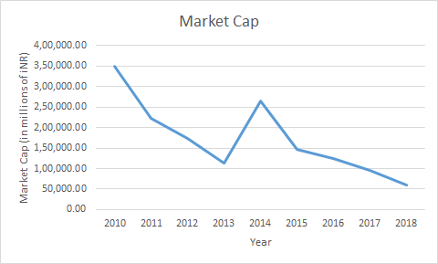
STATS
The market capitalization of RCom spiked in 2013-2014 due to the signing of Ericsson deal.
Source: Bloomberg

Slide 20
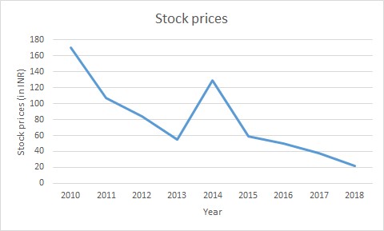
STATS
Due to the positive impact of the deal with Ericsson, the stock prices of RCom shot up in 2013.
Source: Bloomberg

Slide 21
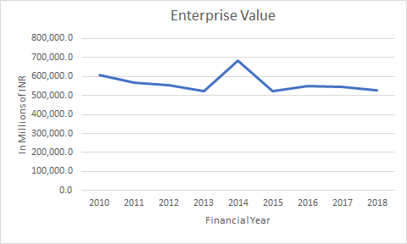
STATS
Due to the positive impact of the deal with Ericsson, the enterprise value of RCom shot up in 2013.
Source: Bloomberg

Slide 22
JIO ENTRY
Captures 43% market share, more than 4 incumbent companies in total
4G market boomed, 95% of phones sold 4G capable
RCom reluctant to switch to 4G, loses out on customers
Free calls makes it worse for RCom, most of its customers used only calls and SMSes
Before Jio, RCom captured 12% market, now negligible

Slide 23
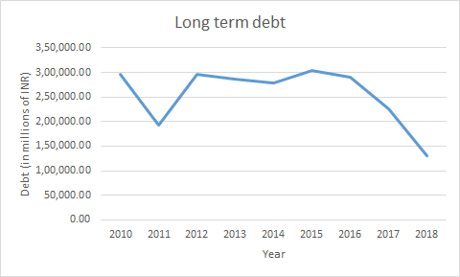
STATS
Due to the entry of Jio, and shift of whatever customers remained to Jio, hurt the company, RCom sold its assets to pay off debt
Source: Bloomberg

Slide 24
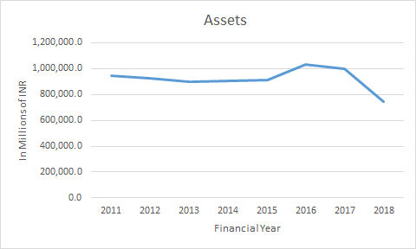
STATS
Decrease in assets can be seen in 2017 as a proof of selling of assets
Source: Bloomberg

Slide 25
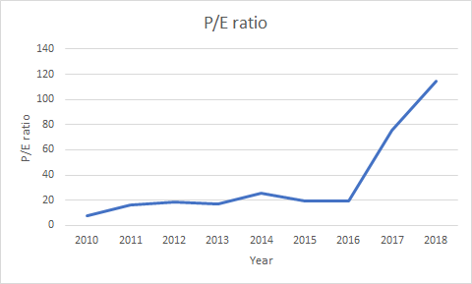
STATS
Due to decrease in earnings, Price/Earnings ratio shot up.
Source: Bloomberg

Slide 26
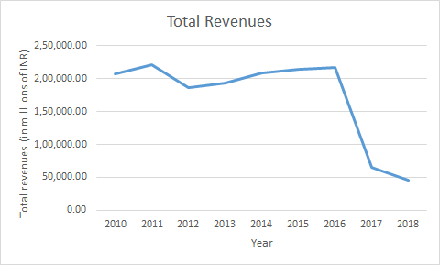
STATS
After the launch of Jio in 2016, almost all companies lost revenue ,because of loss in customer base, including RCom, as it is clearly seen in the graph.
Source: Bloomberg

Slide 27
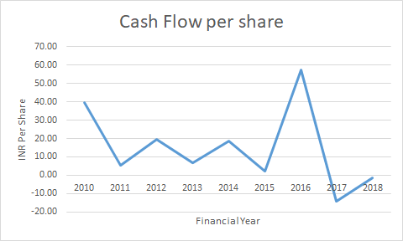
STATS
The cash flow reduced drastically in 2017, as an effect of the Ericsson deal fallout and Jio entry combined.
Source: Bloomberg

Slide 28
Suggestions
Should have invested in upgrading to 4G earlier
Lack of Professionalism (Ericsson Deal)
Should have reported any malpractice immediately or tried to stop it with immediate effect (2G Scam)
Took up too many commitments even when it was starting to lose business (Cloud Xchange, IoT Services Across India and Smart Cities)
Untimely sale of assets
Tillman and TPG - Offer price: 30,000 crore Rs., sold at 8,500 crore Rs to Jio.
Sun TV offer for DTH - 2,500 crore Rs., sold without cash
Notes:
Should have invested in upgrading into 4G earlier. When other players like Airtel, Vodafone, BSNL were dynamically trying to keep up with the technological advancements, they stuck to 2G,which led to them losing a lot of customers.
Lack of Professionalism:
The ericsson deal fiasco occurred mainly because RCom failed to pay dues in time,which is not in honour of the deal.

Slide 29

The secret of change is to focus all your energy not on fighting the old but on building the new.
Socrates
Notes:
Should have invested in upgrading into 4G earlier. When other players like Airtel, Vodafone, BSNL were dynamically trying to keep up with the technological advancements, they stuck to 2G,which led to them losing a lot of customers.
Lack of Professionalism:
The ericsson deal fiasco occurred mainly because RCom failed to pay dues in time,which is not in honour of the deal.

Slide 30
Thanks!
Any questions?

